Slide 1
Analog Electronics Lab Experiment-4
Instructors name:
P3:
Ashish Kumar Varma
Sambhavi Shukla
P4:
Ankita Dixit
Premsai Regalla

Slide 2
Feedback Amplifiers using Op-Amp

Slide 3
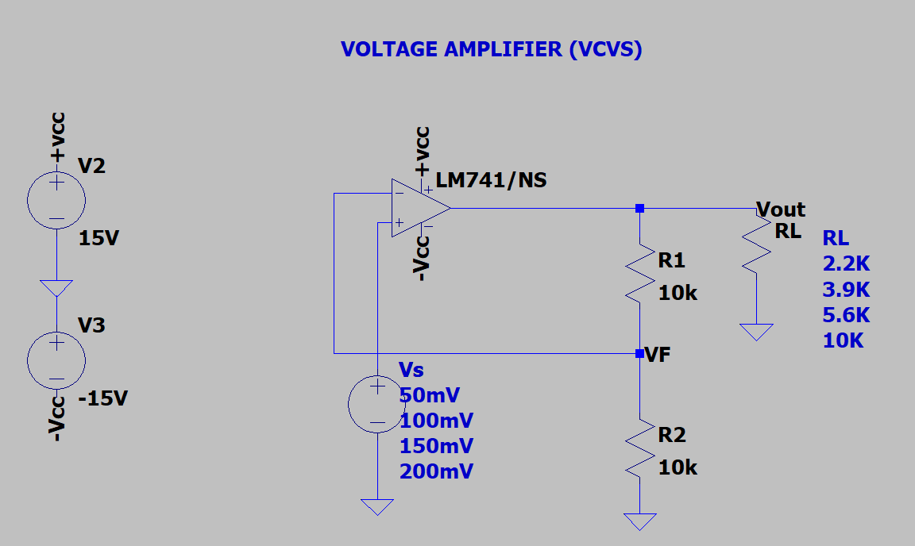
Circuit Voltage Series Feedback Amplifier (VCVS)

Slide 4
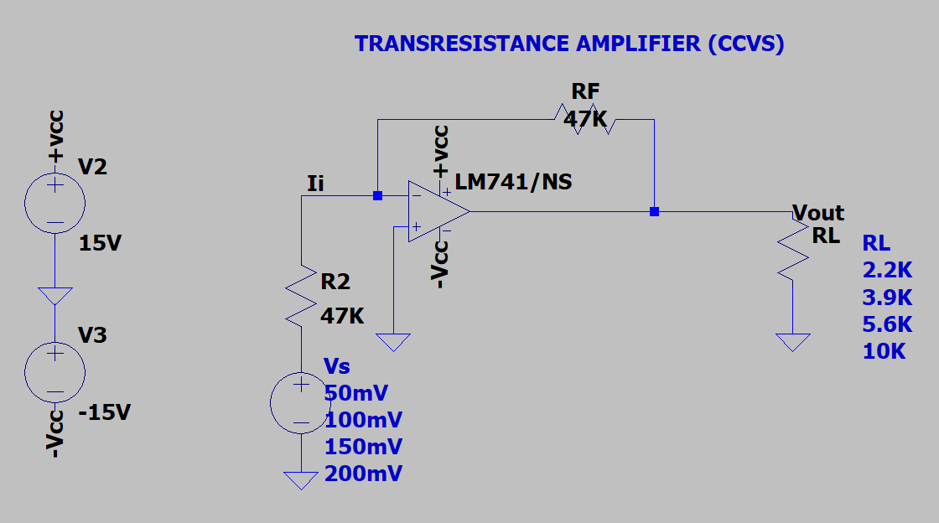
Circuit Voltage Shunt Feedback Amplifier (CCVS)

Slide 5
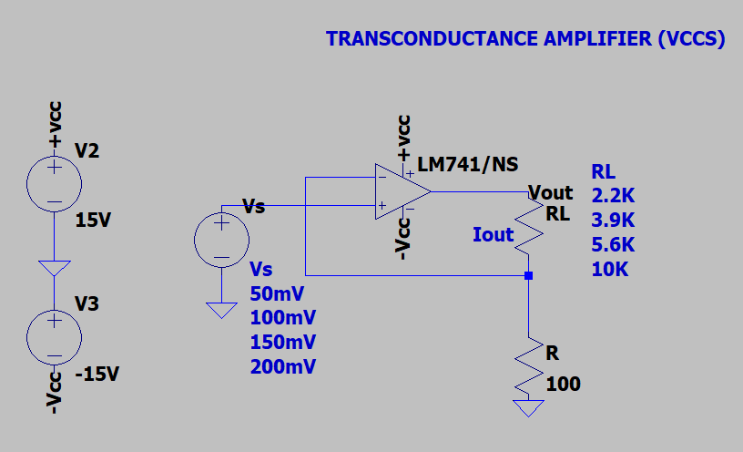
Circuit Current Series Feedback Amplifier (VCCS)

Slide 6
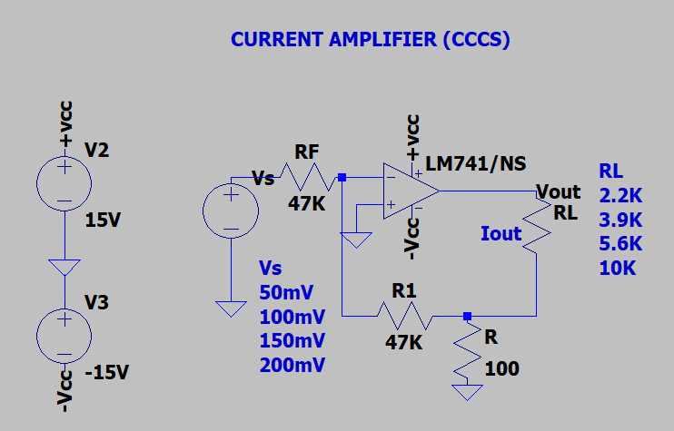
Circuit Current Shunt Feedback Amplifier (CCCS)

Slide 7
Assignment-4:
To study the feedback amplifiers using OPAMP (IC-741)
1) Voltage Series Feedback Amplifier (VCVS)
2) Voltage Shunt Feedback Amplifier (CCVS)
3) Current Series Feedback Amplifier (VCCS)
4) Current Shunt Feedback Amplifier (CCCS)
Upload a single PDF file on Nalanda which includes
1) Circuit diagrams for all four configurations.
2) Calculate Voltage Gain (A_{v}) for all four configurations by
Varying R_{L} with constant source
Varying source with constant R_{L}.
3) Compare the simulated and theoretical values of voltage gain (A_{v}).
Submit the report in a single PDF format (file name should be your ID) on Nalanda within 48 hrs., after your lab section. ( 2 marks deduction for late submission ) Personal submission on email will not be considered.

